Slide 1
Building Permit Mapping
Monthly Report: January 2020 Washington University Medical Center

Slide 2
Academy
6 building permits in Academy in January 2020

Slide 3
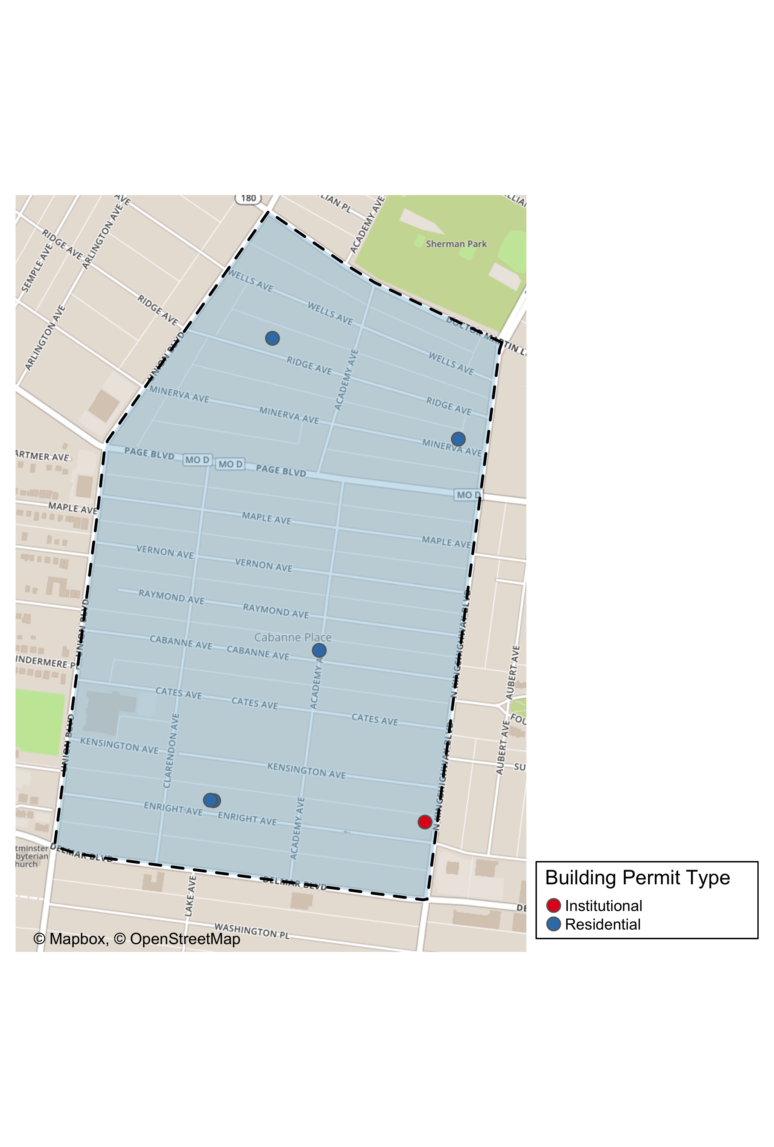
Academy: Building Permit Type

Slide 4
Central West End
40 building permits in Central West End in January 2020

Slide 5
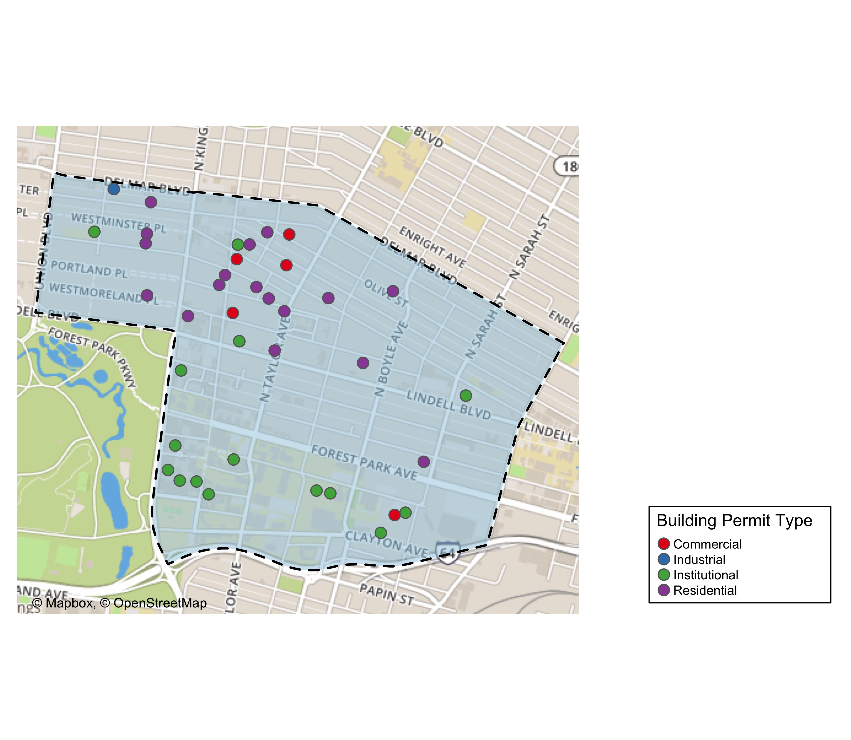
Central West End: Building Permit Type

Slide 6
DeBaliviere Place
6 building permits in DeBaliviere Place in January 2020

Slide 7
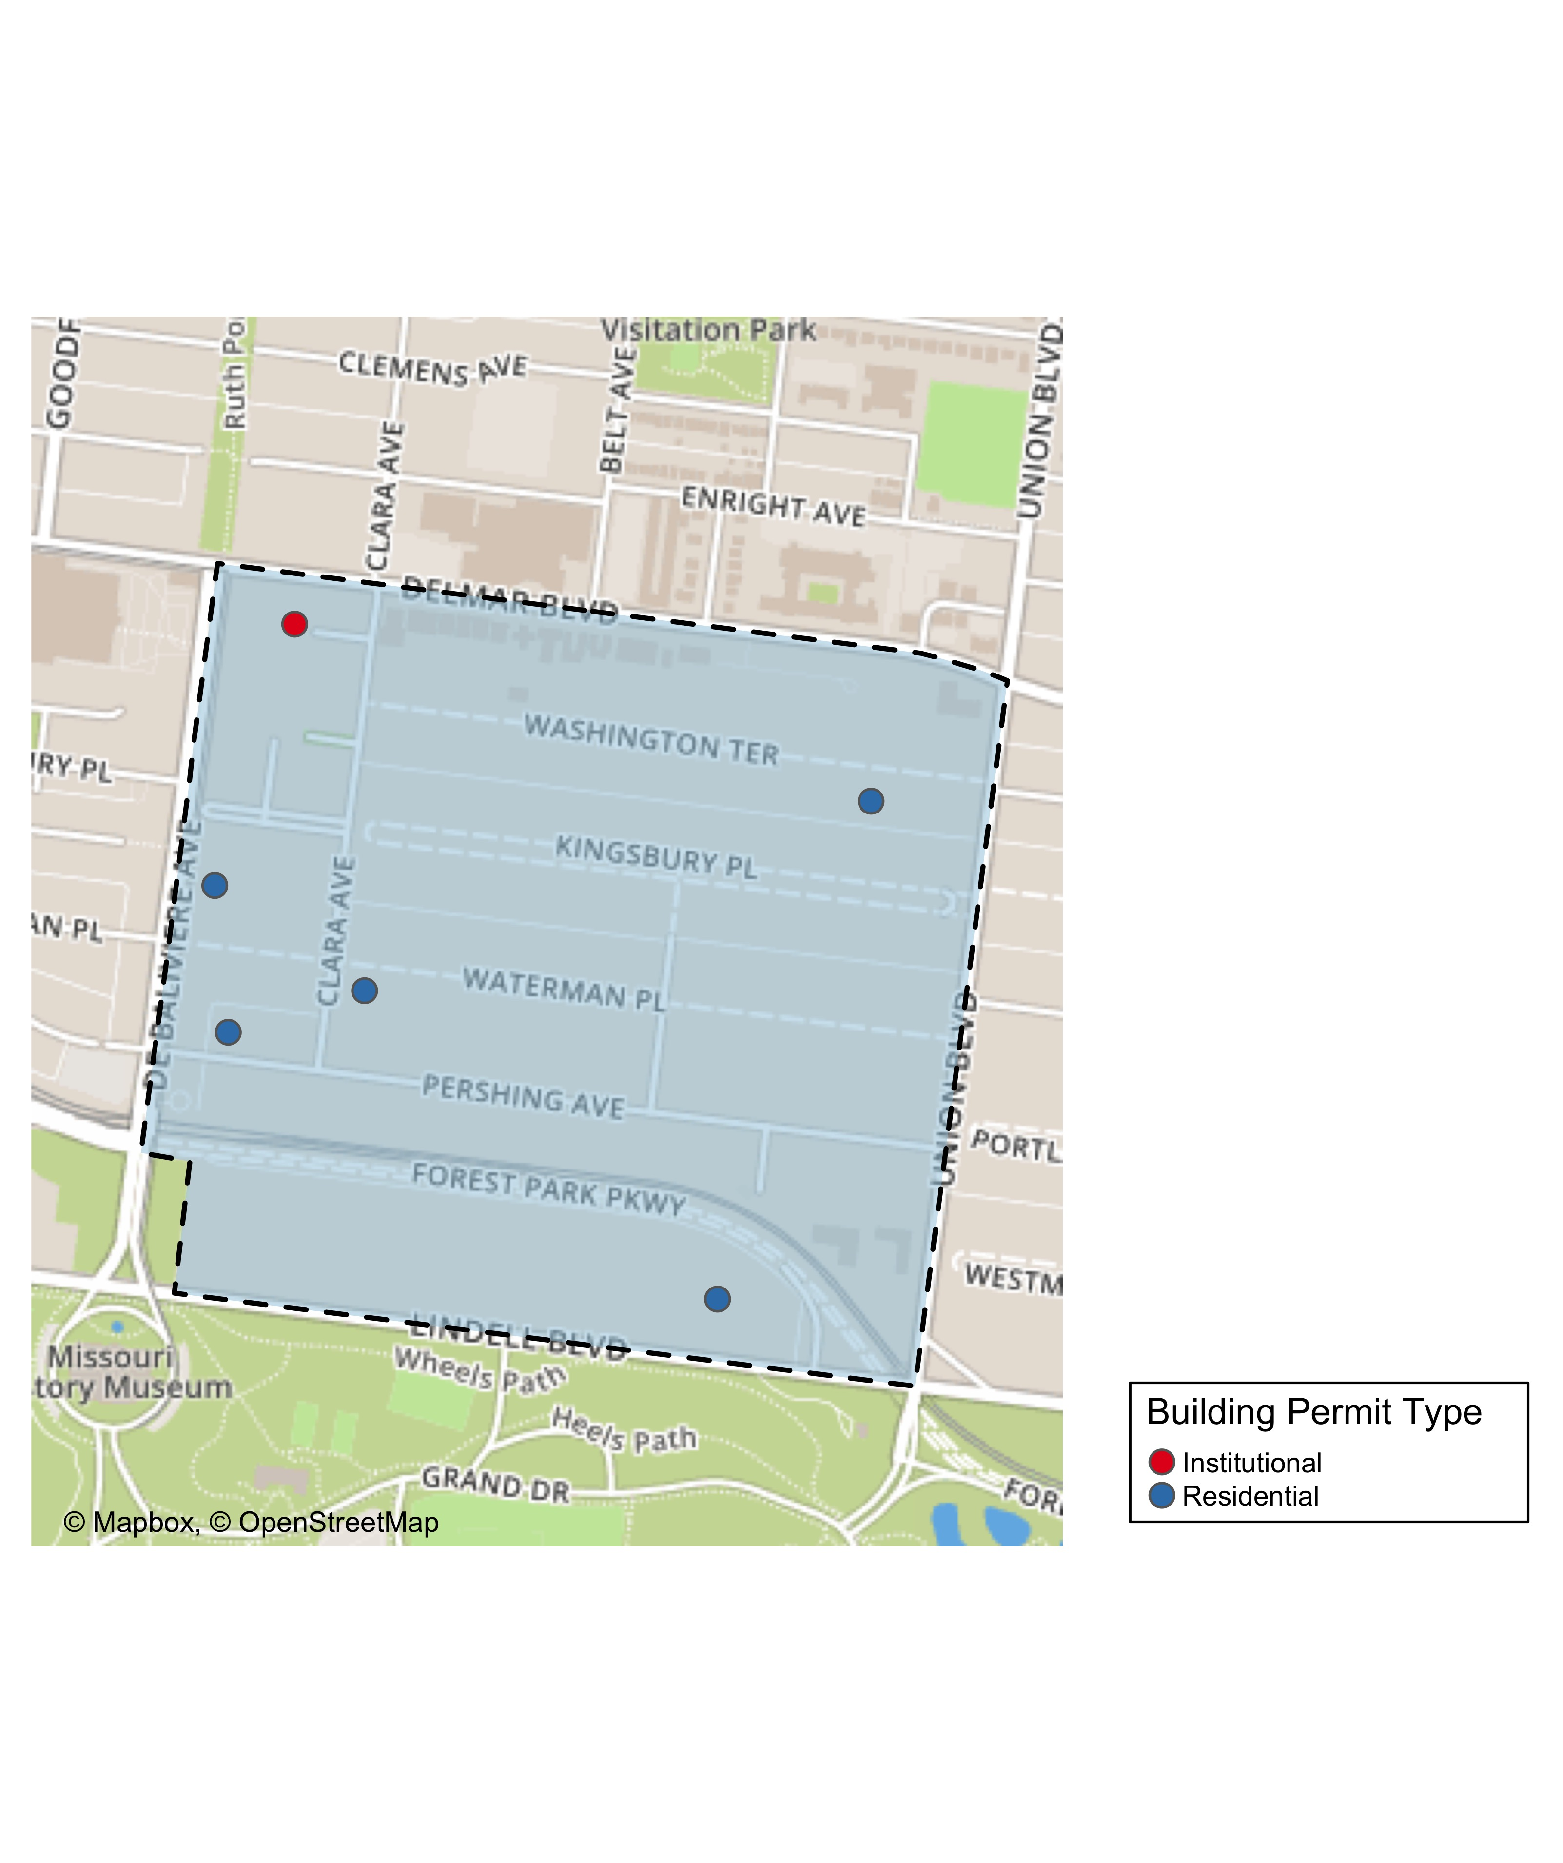
DeBaliviere Place: Building Permit Type

Slide 8
Forest Park South East
13 building permits in Forest Park South East January 2020

Slide 9
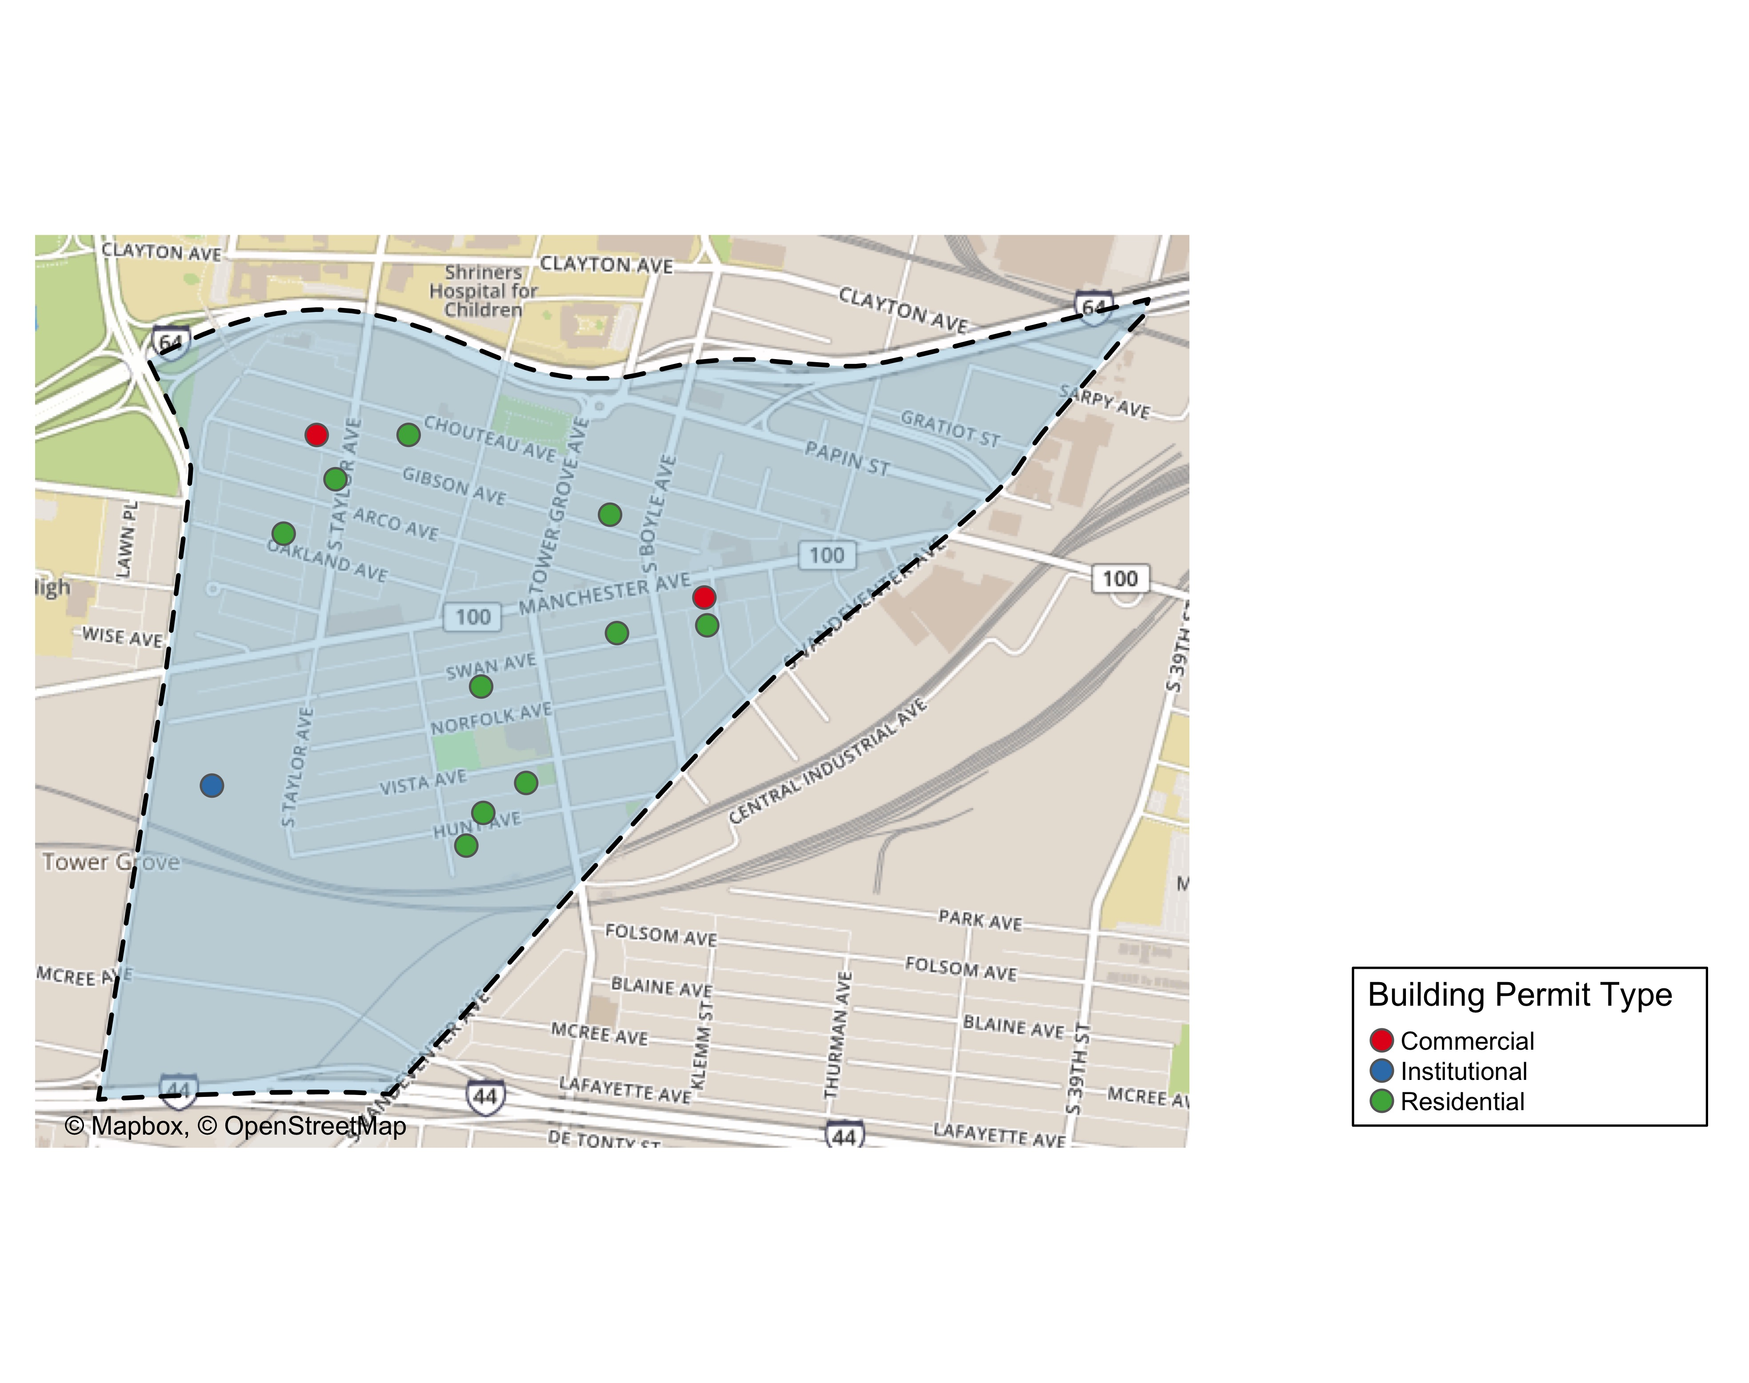
Forest Park South East: Building Permit Type

Slide 10
Fountain Park
0 building permits in Fountain Park January 2020

Slide 11
Fountain Park: Building Permit Type

Slide 12
Lewis Place
1 building permits in Fountain Park January 2020

Slide 13
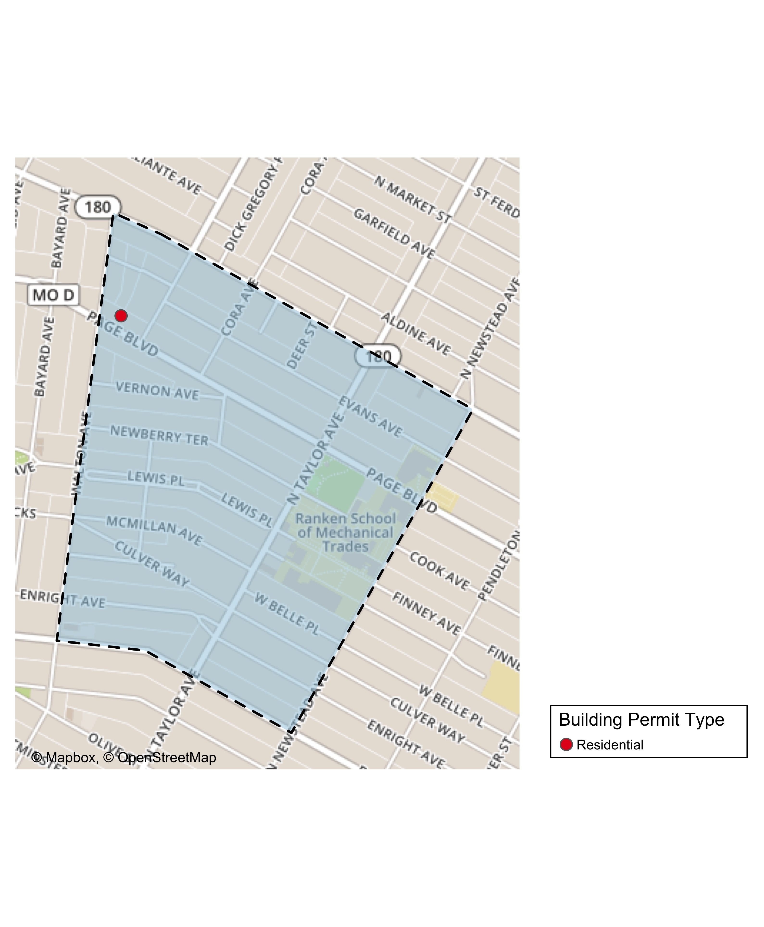
Lewis Place: Building Permit Type

Slide 14
Skinker DeBaliviere
8 building permits in Fountain Park January 2020

Slide 15
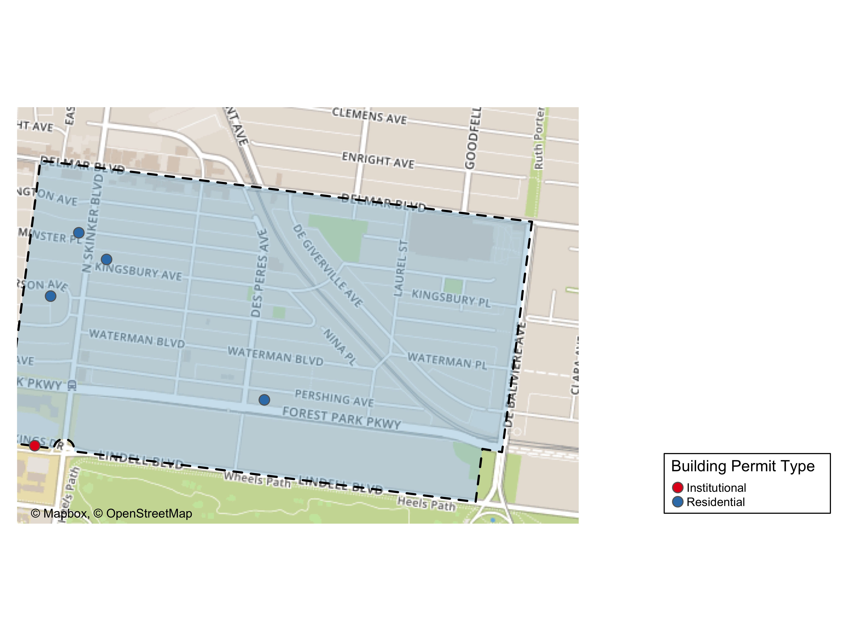
Skinker DeBaliviere: Building Permit Type

Slide 16
Vandeventer
2 building permits in Fountain Park January 2020

Slide 17
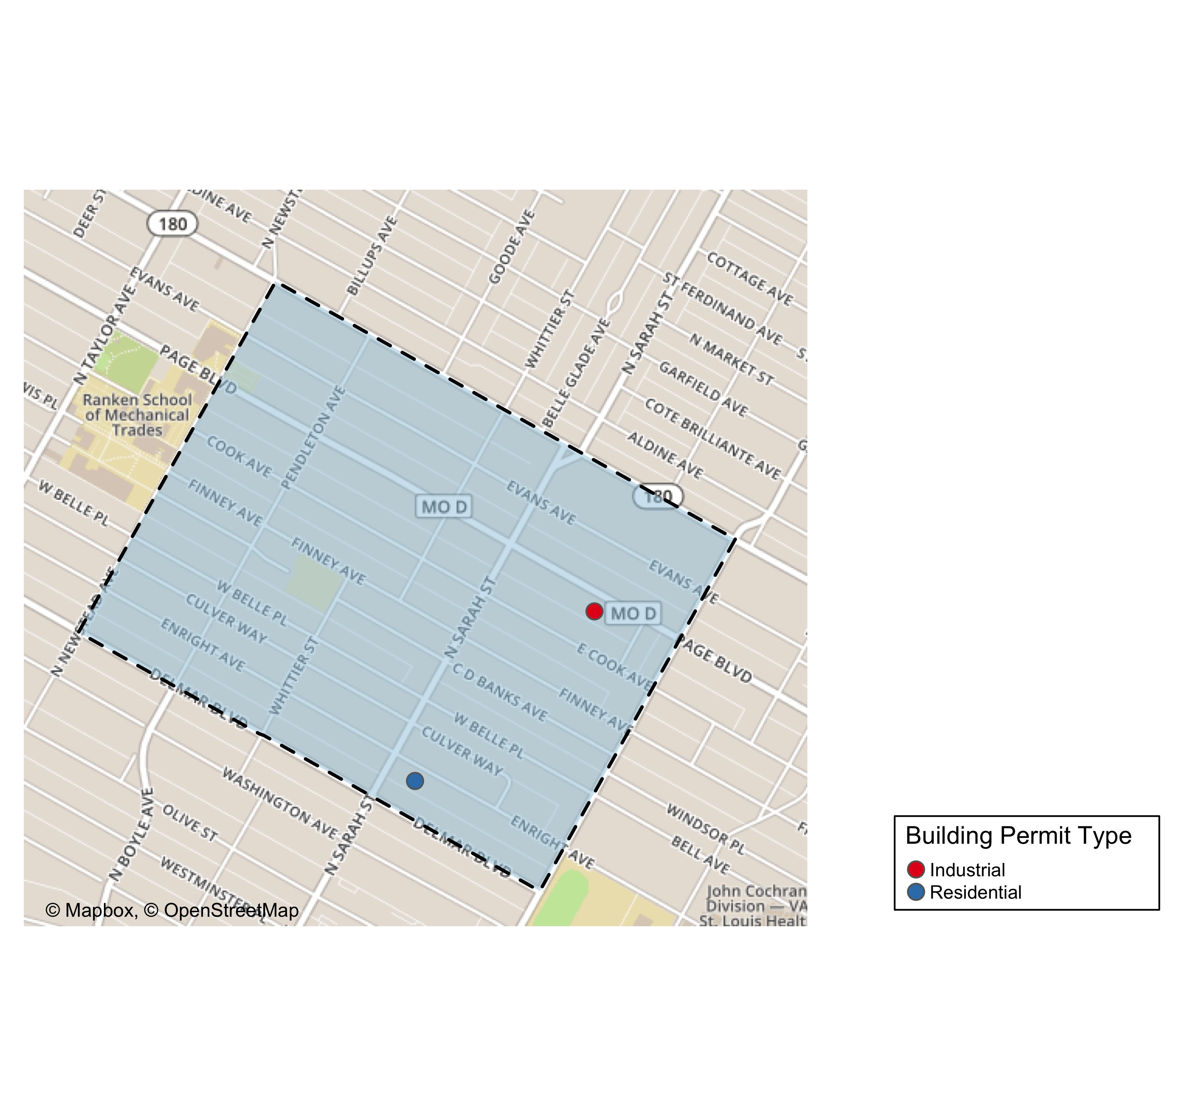
Vandeventer: Building Permit Type

Slide 18
Visitation Park
0 building permits in Fountain Park January 2020

Slide 19
Visitation Park: Building Permit Type

Slide 20
West End
12 building permits in Fountain Park January 2020

Slide 21
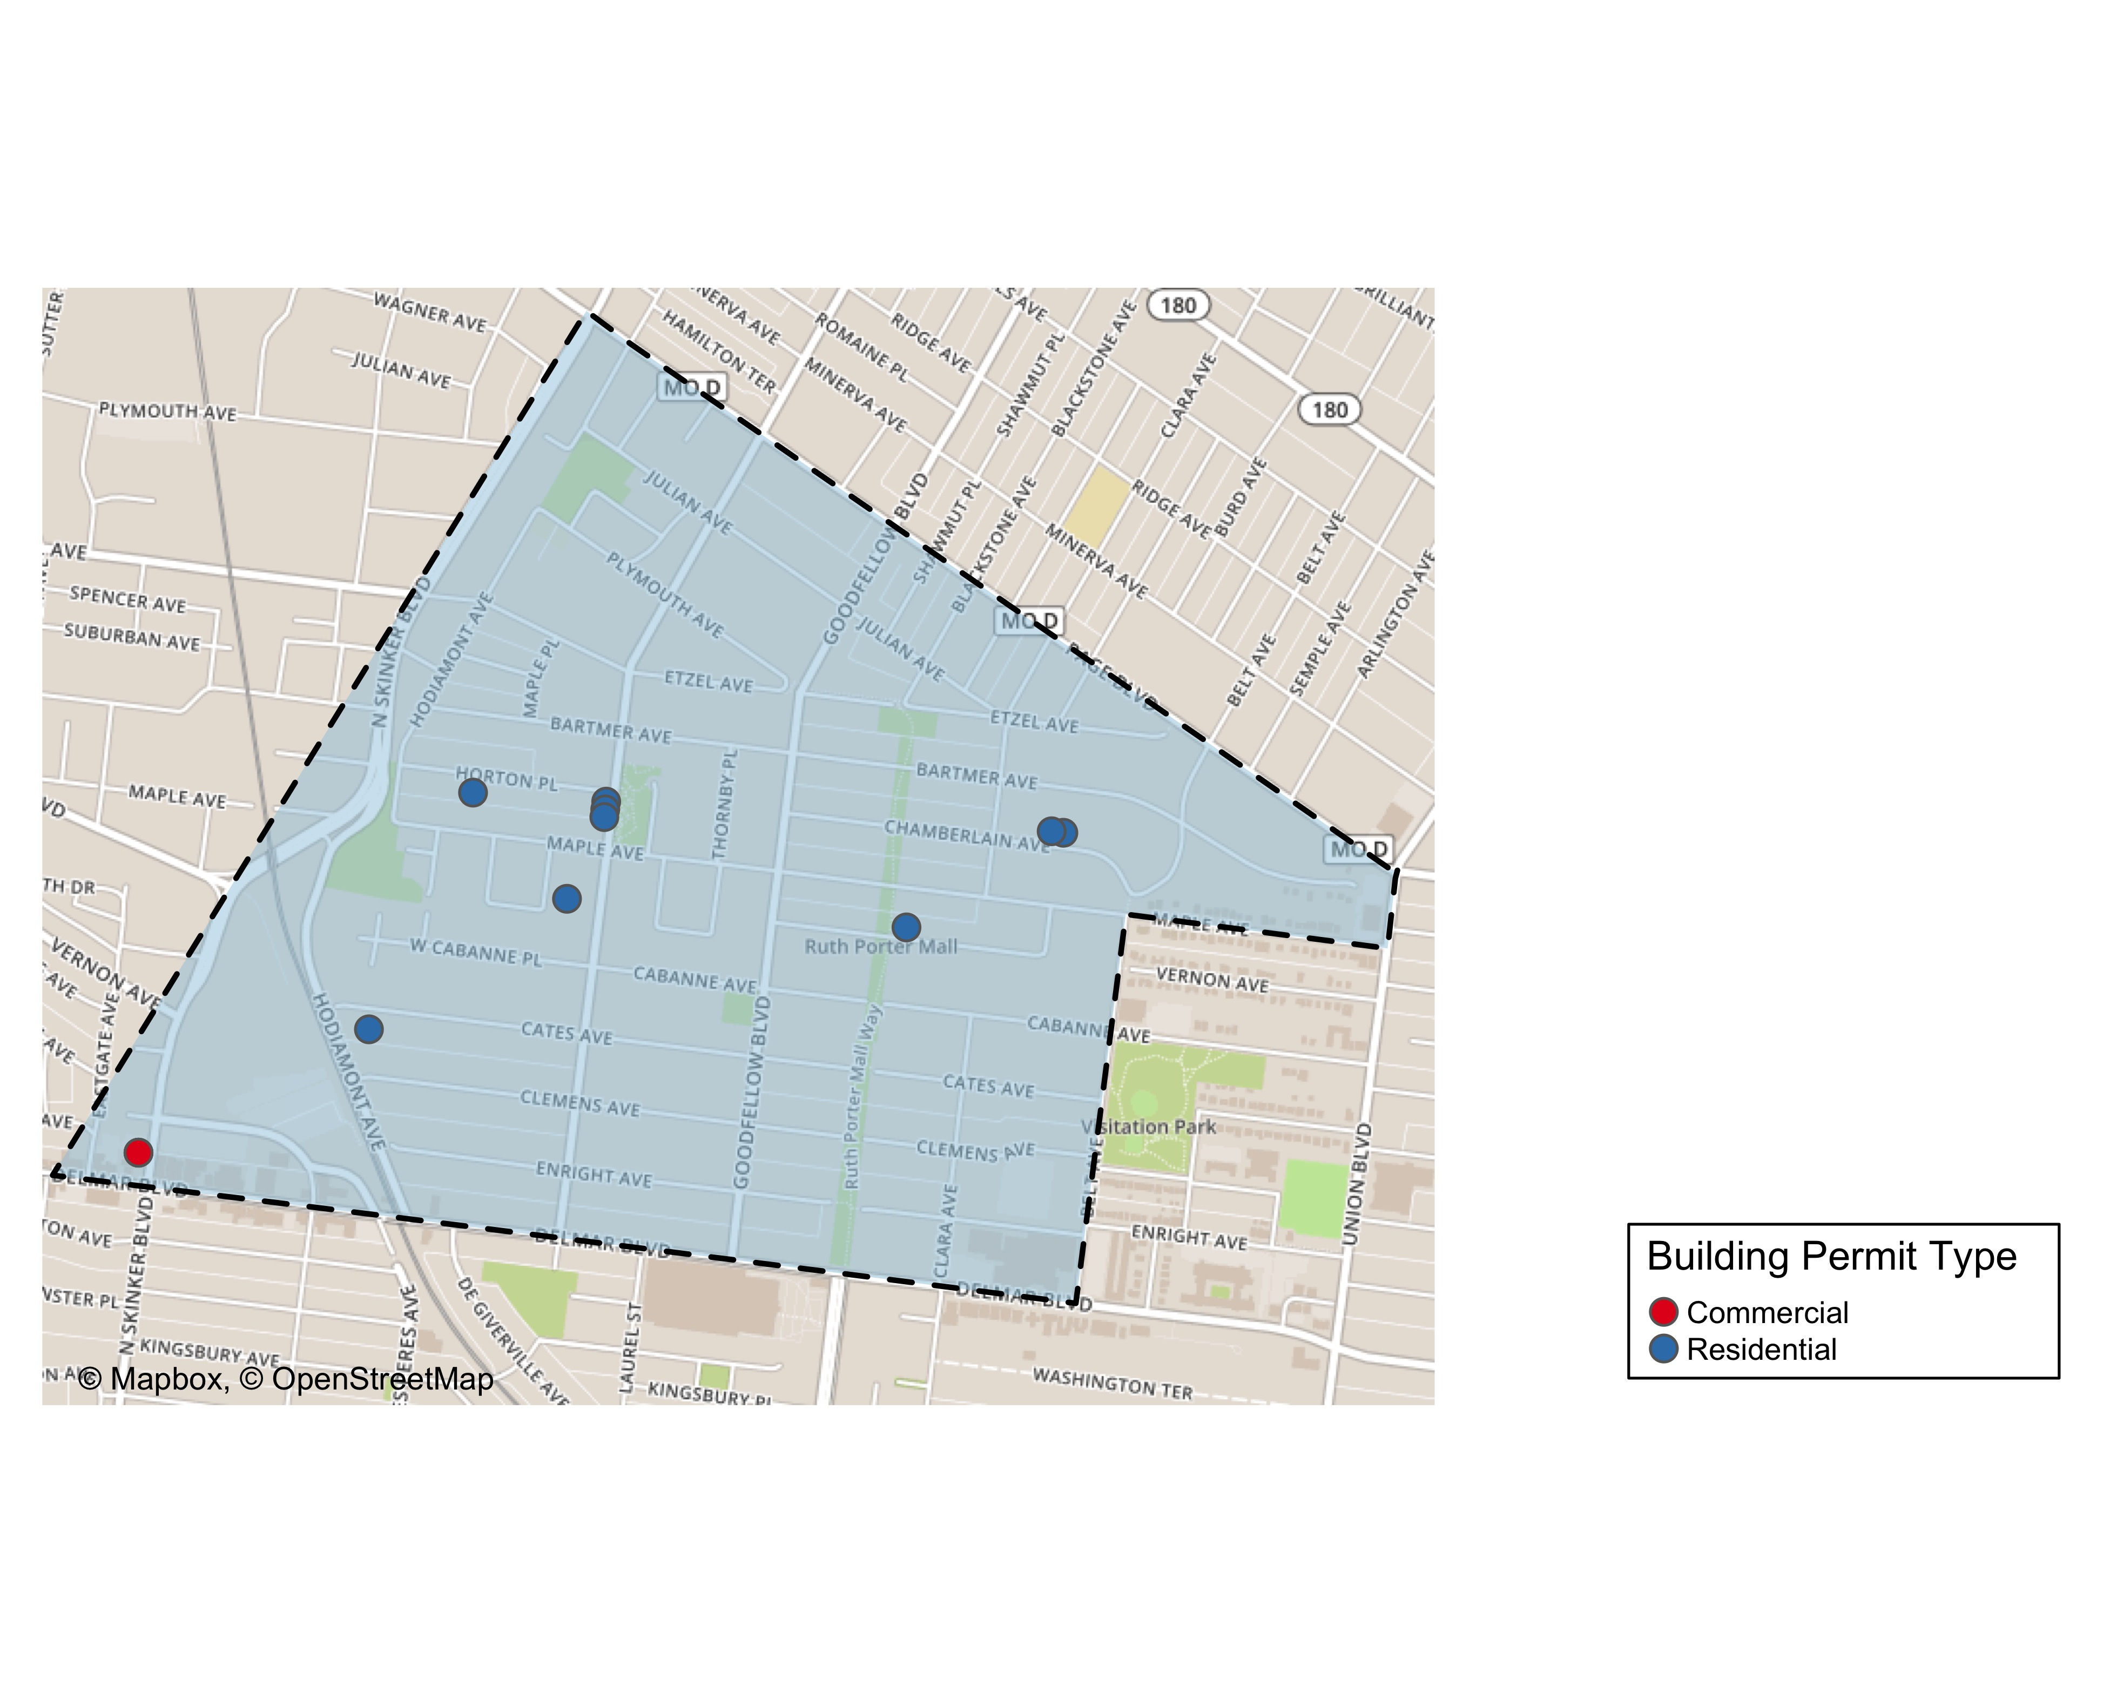
West End: Building Permit Type

